Slide 1
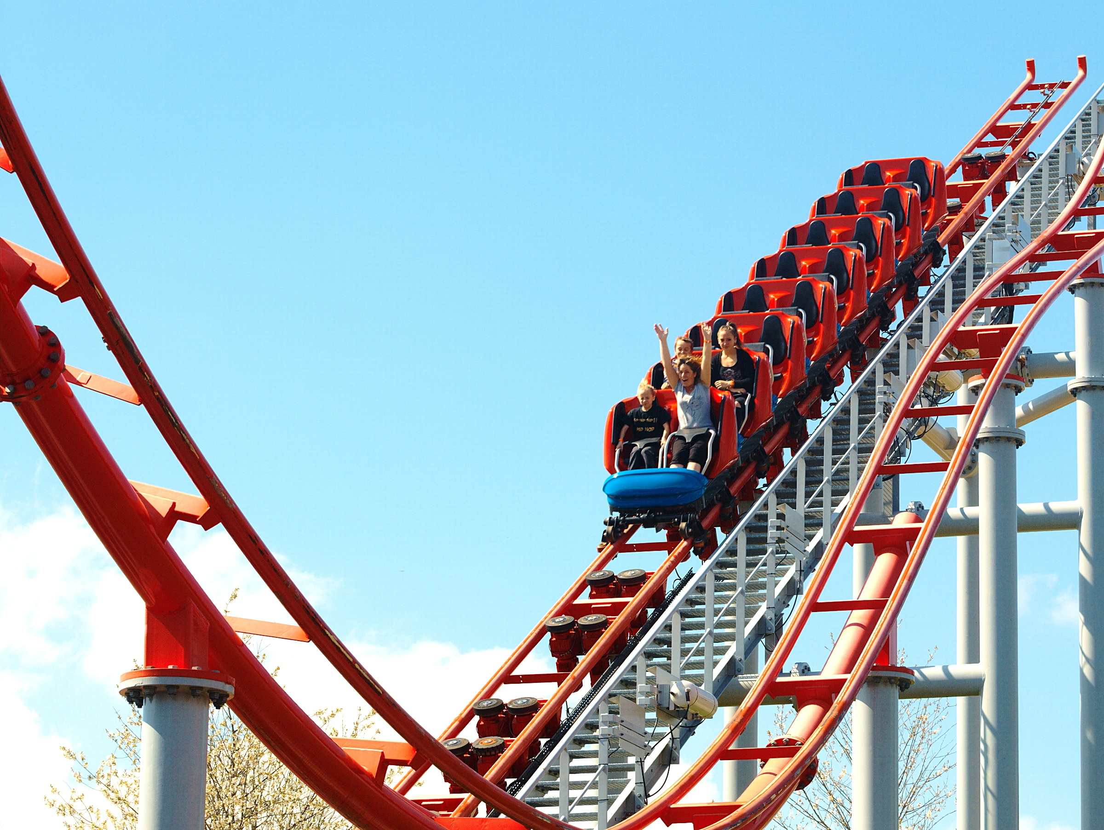
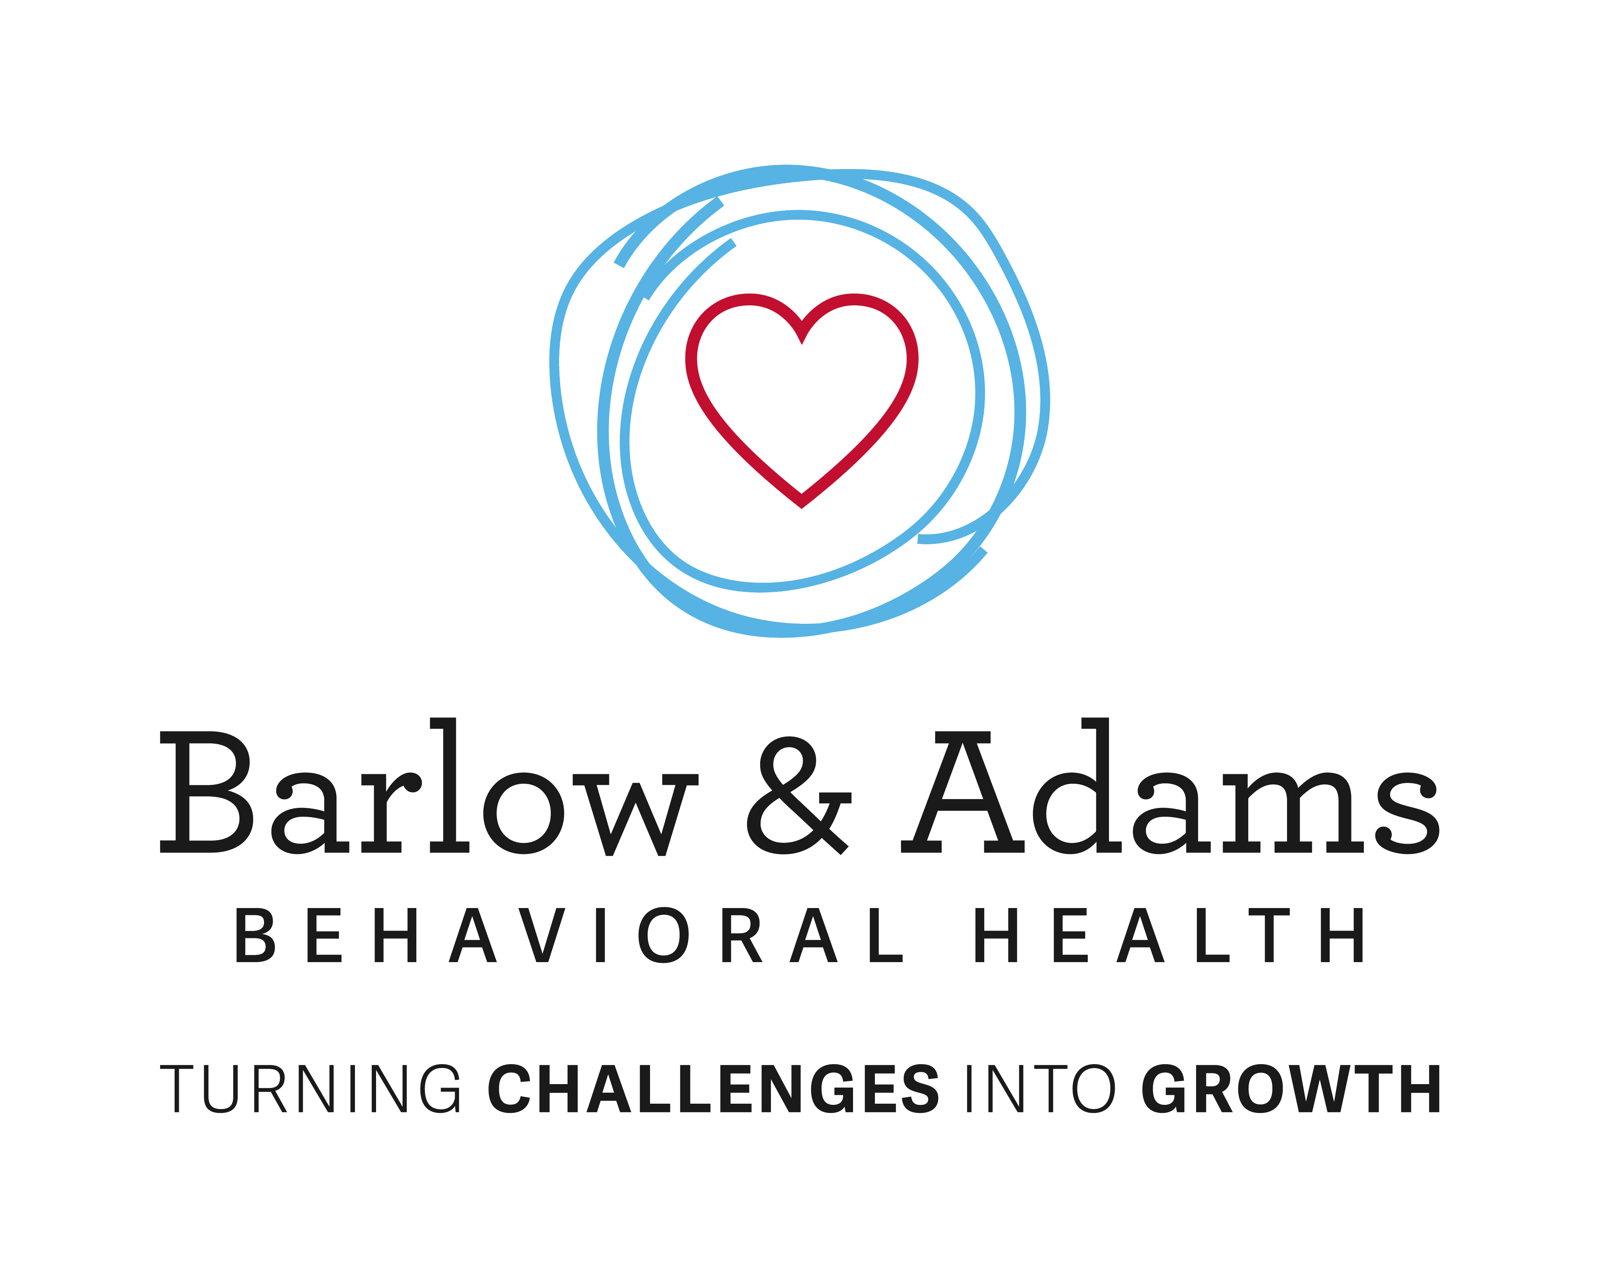
Navigating BIG Feelings: An Art and A Science
Meghan Barlow, Ph.D.
Pediatric Psychologist

Slide 2
Managing
Navigating

Slide 3
Feelings vs Behaviors
Fear
avoid
seek reassurance
Anger
yelling
aggressive acts

Slide 4
Feelings Just Are
Shift from thinking about “good” or “bad”
Normal, healthy, and human to experience a range of emotions
Importance of opposites – Joy and Pain…sunshine and rain (Rob Base & DJ E-Z Rock, also Taoism)
Individual differences – degree of sensitivity and intensity
Temperament and wiring
Communicate information or “clues” that could be important

Slide 5
Your child’s feelings are not yours to manage,
though you will often be along for the ride.
You can help guide them through and find their way.

Slide 6
Behaviors are for Managing and Preventing
Teaching what’s appropriate/not appropriate; allowed/not allowed
Directly
Modeling
Shaping the behavior
A (Antecedents) B (Behavior) C (Consequences) – then hypothesize what the function of the behavior is (what does the behavior get them or get them out of?)
Change the environment - set the stage
Strong foundation
Sleep, nutrition, exercise, fresh air

Slide 7
Not Just Semantics
Language shapes the way we think…and the way we talk to our kids…and they internalize those messages
Our self-talk influences the way we feel and that influences our behavior (what we do/do not do)…our behavior towards our kids in those moments can be a powerful reinforcer or punishment
The feelings are not problematic in and of themselves, but the way your child feels affects how they behave and their behavior could be a problem or not (or, as we like to say: maladaptive or adaptive).

Slide 8
Situation: Your kid is one of the only kids not invited to a classmate’s party. They feel left out.
This is
unbearable!
Protective
Worried
Angry
Talk a lot
Ask a lot of ?

Slide 9
A
B
C
Your kid finds out
they are not invited
to a birthday party
Your kid tells you they
were not invited to the
party
You talk a lot,
you ask a lot of
questions
***If the attention and time you give asking questions and talking is a reward, your child will continue to tell you these kinds of things; if it’s a punishment, they will not tell you as often when these types of things happen

Slide 10
Please get to the strategies…

Slide 11
Explosions, Meltdowns, Shutdowns
#1) Collect yourself – pause, take a breath, slow down
#2) Detach – step back and label, “wow, she’s really having trouble”
#3) Validate – “mirror”/reflect their feelings, repeat their words…
keep it short and simple
#4) Wait for the break (here’s where the art comes in) – clues: volume changes, face softens, gaze changes, slowing down, “yes and…”
#5) Normalize/Ground – bring intensity of language down a notch, take your body language and tone in the direction you want them to go
#6) Offer support, comfort, suggestions, space

Slide 12
If Pattern of Behavior is Maladaptive
When child is calm, address the problem behavior
“It seems like you’re feeling a little better now, and I’m glad. I know when you’re feeling ____, it’s hard to {think clearly/calm down} and it’s hard to stop yourself from {insert problematic behavior}. I’m also pretty sure that when you’re {calm/feeling better}, you know that {problematic behavior} is not ok and maybe you can even see how it makes the situation worse sometimes.”

Slide 13
If Pattern of Behavior is Maladaptive
Wait for acknowledgement (or excuse), offer reassurance that you’re not mad and they’re not getting in trouble…this is not about what already happened, you’re not looking for them to take responsibility or ownership…if they try to bait you, don’t bite
“Yeah, I get it. It happens. And I know, at some point, you’re probably going to feel ___ again and it might be hard to {think clearly/calm down} and you might feel like {problematic behavior}. But since {problematic behavior} isn’t ok and also doesn’t really seem to end up making you feel better – it actually seems to make the situation worse in some way – I wondered if we could try to think of other things you can do when you’re feeling that way.”

Slide 14
Now What?
If they agree
brainstorm together and agree on trying a plan you both think is realistic and reasonable. Then try. And repeat this process making adjustments and tweaks as needed.
If they don’t agree:
don’t take it personally, don’t take the bait
drop the subject for now – “ok, well, you can think about that if you want.”
give it a little time (here’s the art again) and then broach the subject again
“I think I might have an idea about what we could try….” WAIT
“I saw something on tiktok/youtube/Instagram” or “I heard something from {person of interest]”

Slide 15
But Really…What?
You know what you don’t want them to do when they feel ____
What behavior would be (more) acceptable (not what behavior would be ideal) ?
What behavior(s) could lead to solving a problem, calming down, or thinking more clearly?
Think about the typical consequences they experience when they do the problematic behavior(s)
Since this is a pattern of behavior, there is very likely some reinforcement (reward)
Natural, “manmade,” immediate, delayed, physiological
What function does the behavior serve?
What, more adaptive behavior, could be put in place to do the job? How do we make sure the more adaptive behavior is reinforced?

Slide 16
And Get More Help if Needed
Could be related to an underlying psychological condition (ADHD, anxiety, mood disorder, OCD, LD, ASD, etc) that might require specialized interventions or accommodations to improve – the problematic behavior reflects an unmet need, a skill deficit, expectations/demands being out of reach
Could be related to abuse, trauma
Could be related to a physical/medical condition requiring treatment

Slide 17
Next Up
11/6 - Stressed Out About Anxiety

