Slide 1
Stressed Out About Anxiety?
Meghan Barlow, Ph.D.
Pediatric Psychologist

Slide 2
What Are We Talking About?
Feeling anxious in a moment
Stress
Situational discomfort
Temperamentally anxious
Anxiety disorder(s)

Slide 3
Caveman Brain
On alert for danger
Fight, flight, freeze
Protective, helpful
Paralyzing, maladaptive

Slide 4
Interference with Functioning
Does it stop my kid from doing something they want to be able to do?
Do we feel bossed around by this fear or worry?
Does it get in the way of my kid doing things that other kids their age typically do?

Slide 5
And Parents Ask
Did I cause this?
What did cause this?
Many potential causes
Interesting theory from Jonathan Haidt re: rise in generational anxiety – overprotection in real world, underprotection in virtual world
What can I do to help? What would make it better? Worse?
How much do I push?

Slide 6
Anxiety peaks…everyone feels bad
Escape/Avoidance
Seek reassurance
*kids and parents*
Anxiety builds
Relief

Slide 7
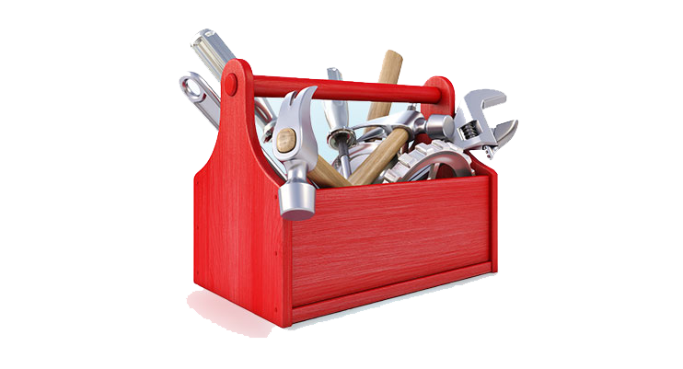
Anxiety peaks
This Photo by Unknown Author is licensd under CC BY-NC
Anxiety builds

Slide 8
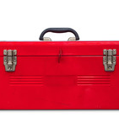
Tools and Strategies
Relaxation
Deep belly breathing
Muscle relaxation
Distractions
Helpful, encouraging self-talk
Small steps, break it down into something more manageable
Medication?

Slide 9
Thinking, Reasoning, Logic
Am I actually in danger?
How likely is the possibility?
How bad would it actually be?
This Photo by Unknown Author is licensed under CC BY-NC

Slide 10
Making Plans and Problem Solving
If it does happen, here’s how I can handle it …
What would help me get through the uncomfortable part?
Who can help me get through the uncomfortable part?
What information can I get to help me feel comfortable?

Slide 11
Cognitive Appraisal Model of Stress
Event
How Bad?
Can I Deal?

Slide 12
Allow Opportunities to Develop
Practice letting your kids out of your sight, without a way to reach you…even when they’re at school
When there is an adult in charge, parents back up and watch from sideline
Camps, sleepovers, adventures away from home
Put them in charge – of others, of themselves, of actual responsibilities

Slide 13
Allow Opportunities to Internalize
Find moments they showed bravery, resilience, good problem-solving, facing fears and tell those stories!
Stories from when they were little, present day
Stories about you/family members
Stories from characters in shows, movies, books
Stories where everything doesn’t work out…and it’s ok
Stories where things start out rough and scary and get better

Slide 14
Self-Reliance and Pride
“I’ll figure it out”
“I can handle this”
Parents can reinforce, guide, provide information/clarity

Slide 15
Key Point For Parents
Even though your kids will try to get a guarantee from you that (bad, scary thing) won’t happen, AVOID giving reassurance/guarantee that (bad, scary thing) won’t happen
Instead, reassure that if it happens, they’ll get through it (or they can deal with it)
Put the focus on how they can cope with discomfort or (bad, scary thing)
Outside of the (bad, scary thing), reinforce messages of capability, resourcefulness, bravery, coping, resilience

Slide 16
Resources
Understood.org
Childmind.org
Go Zen (www.gozen.com)
What to Do When You Worry Too Much (and many other workbooks)
Talk to PCP and/or school for referrals/resources
www.barlowandadams.com - Three Things You Need to Know: An Anxiety Guide for Kids, Teens, and Adults

